Slide 1
DECODING DEATH
Predicting Death By US State

Slide 2
Project Participants
01
02
03
04
IAN LEE
NAVDEEP KAUR
PAUL KU
JEFF MORGAN
05
BYRON DE LEON

Slide 3
About
For Project 4, our team worked with machine learning (ML) with the other technologies we've learned solve, analyze, and visualize a project decoding opensource information to discover a problem worth solving, analyzing, or visualizing.

Slide 4
Introduction
Our group project attempts to analyze provisional counts of deaths by state and select causes for the years 2020-2023. The ultimate goal was to predict the most likely causes of death in each state for 2024.

Slide 5

Data Source
Weekly Provisional Counts of Deaths by State and Select Causes, 2020-2023
https://data.cdc.gov/NCHS/Weekly-Provisional-Counts-of-Deaths-by-State-and-S/muzy-jte6/about_data

Slide 6
Causes of Death
01
02
03
04
05
Heart Disease
Malignant Neoplasm
Coronavirus (COVID-19)
Range of conditions that affect the heart
Cancers
Infectious disease caused by the SARS-CoV-2 virus
Respiratory Disease
Cerebrovascular Disease
Asthma, Chronic Obstructive Pulmonary Disease (COPD)
Group of conditions that affect the blood vessels and blood flow in the brain and spinal cord.

Slide 7
Causes of Death
06
07
08
09
10
Alzheimer Disease
Diabetes mellitus
Nephritis
Degenerative Disease of the Nervous System
A metabolic disease, involving inappropriately elevated blood glucose levels
An Inflammatory Kidney Disease
Influenza/Pneumonia
Not Elsewhere Classified
Flu-Common Cause of Pneumonia

Slide 8
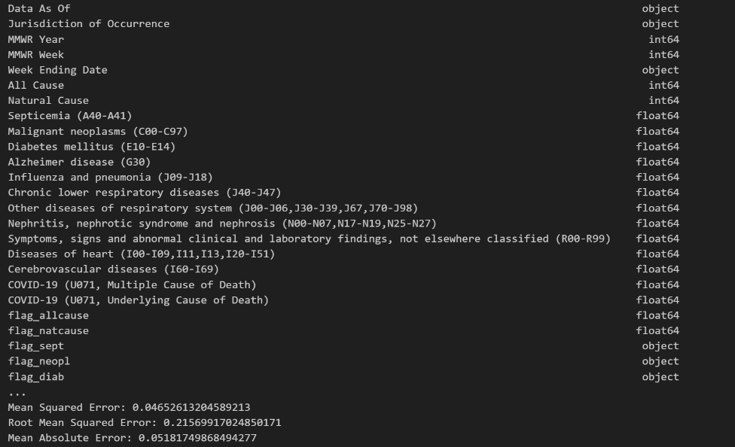
METHODOLOGY
Our Group stared by working with a Python script using pandas for data manipulation and scikit-learn for machine learning tasks, particularly regression analysis.

Slide 9

Breakdown of Data Processing
Do you know what helps you make your point clear? Lists like this one:
Converting the "Week Ending Date" column to datetime format.
Created new columns for year, month, and day extracted from the "Week Ending Date".
Aggregated the data by year, month, and jurisdiction of occurrence, summing up the "All Cause" column.
Handling Missing Values: You've printed the count of missing values in the aggregated dataset.
One-hot encoding was performed on the "Jurisdiction of Occurrence" column to encode the categorical variables.
Scikit-learn was used to standardize the numerical feature
The dataset was split the into training and testing sets.

Slide 10
Dependencies
Python Libraries: pandas, numpy, scikit-learn
Make sure to install these dependencies using the following command
pip install pandas numpy matplotlib scikit-learn

Slide 11
Modeling & Training
Modeling
(DecisionTreeRegressor)
Mean Squared Error (MSE)
Root Mean Squared Error (RMSE)
Mean Absolute Error (MAE)
R-squared.
(GridSearchCV) Finds the best hyperparameters for the decision tree regressor model.
Trained final decision tree model for best performance
Final Training
Notes:
We trained a decision tree regression model (DecisionTreeRegressor) on the training data and evaluated its performance on the testing data using metrics such as Mean Squared Error (MSE), Root Mean Squared Error (RMSE), Mean Absolute Error (MAE), and R-squared. Later, we performed hyperparameter tuning using grid search (GridSearchCV) to find the best hyperparameters for the decision tree regressor model.
Finally, we trained another decision tree regression model with the best hyperparameters found from grid search and evaluated its performance on the testing data.

Slide 12



Slide 13

Tableau
Purpose of the Dashboard: To provide a clear, visual representation of mortality data across the United States, highlighting key trends and causes of death.
Visualization: Map showing the count of deaths by all causes by state. shows states California and Texas with the highest and state Alaska is with lowest mortality rates.

Slide 14
Tableau
Most Deadly Diseases by State
Visualization: Dual axis chart for each state comparing the most deadly diseases.
diseases with the highest mortality impact per state are diseases of heart and Malignant neoplasms.
Top 10 Deadly Diseases Nationwide
Visualization: Bar chart showing the top 10 deadliest diseases.
Yearly Death Trends by Cause
Visualization: Heat Map showing the trend of deaths by all causes over the years.
Forecasting Death Trends into 2024
Visualization: Forecast line chart projecting deaths into the year 2024.

Slide 15
Summary
Machine Learning – Trying to DECODE(Predict) Death.
CDC Data
Data Cleaning
Modeling
Training Model(Prediction)

Slide 16
Summary - Implications
Implications for Public Health Policy
Discussion Points:
Resource Allocation:
"By analyzing state-by-state mortality data, policymakers and public health officials can identify regions most in need of healthcare resources. This targeted approach allows for more efficient use of funds and manpower, focusing efforts where they are most needed to save lives.“
Preventive Strategies:
"The dashboard highlights diseases with the highest mortality rates, providing a basis for developing targeted preventive measures. By understanding these patterns, health departments can implement specific health programs, screenings, and education campaigns to prevent these conditions.“
Interstate Collaboration:
"Many health challenges do not respect state boundaries. This data encourages states to share insights and successful strategies for combating common diseases. Collaborative efforts can lead to innovations in treatment and prevention, benefiting a wider population."

Slide 17
Summary – Call to Action
Summary:
"Today, we've explored significant trends in mortality across the United States, identifying key diseases and forecasting future trends. Our dashboard serves as a critical tool in understanding and reacting to these patterns."
Call to Action:
"I urge everyone here to further explore the dashboard and utilize the data in your own contexts, whether in planning, policy-making, or public health advocacy. Your engagement is vital in turning this data into actionable insights that can lead to better health outcomes."
Thank You:
"Thank you all for your attention and interest. I look forward to your questions and the discussions that I hope will follow."

